Slide 1
English Idioms & Proverbs Quizz

Slide 2
Actions
than

Slide 3
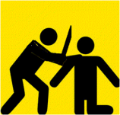
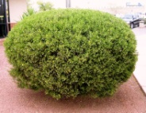
around the

Slide 4
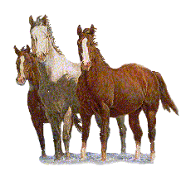
your

Slide 5
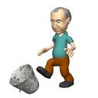

Slide 6
Let it

Slide 7
Something’s

Slide 8
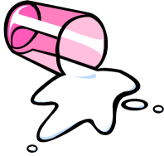
the

Slide 9
The

Slide 11
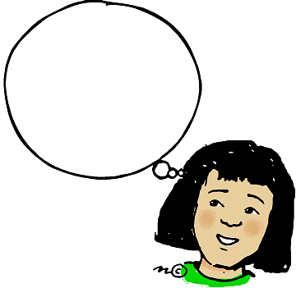
A
for
your

Slide 12
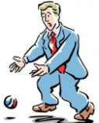
At the
of a

Slide 13
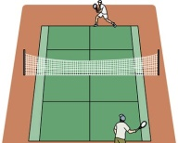
The
is in your

Slide 14
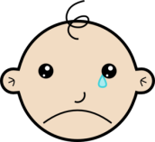
over

Slide 15
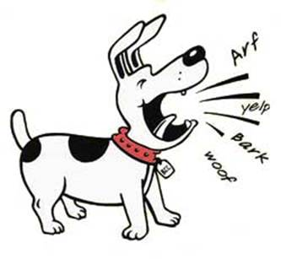
up the wrong

Slide 16
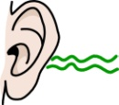
it on the

Slide 17
Miss the

Slide 18
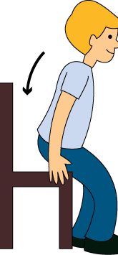
on the

Slide 19
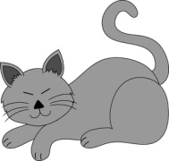
killed the

Slide 20
The key
Actions speak louder than words.
Beat around the bush.
Hold your horses.
Kick the bucket.
Let it ride.
Something’s fishy.
Spill the beans.
The last straw.
Time flies.
A penny for your thoughts.
At the drop of a hat.
The ball is in your court.
Don’t cry over spilt milk.
Barking up the wrong tree.
Hear it on the grapevine.
Miss the boat.
Sit on the fence.
Curiosity killed the cat.

